Slide 1
FACIAL EMOTION DETECTION USING CNN

Slide 2
ABSTRACT
Facial expression recognition has been the subject of an increase in studies over the past several years due to its significance and influence in the interaction between people and computers.
Application of deep learning techniques has become essential due to the rise in the amount of difficult datasets.
In order to identify the seven emotions that may be seen on human faces—anger, fear, disgust, happiness,neutral, sad, and surprise—this research examines the difficulties of Emotion Recognition Datasets. We also experiment with various parameters and topologies of Conventional Neural Networks (CNNs).
For training, we utilised the Fer2013 dataset.

Slide 3
EXISTING SYSTEM
The working principles, benefits, limitations, and accuracy of each algorithm used for feature extraction in existing emotion recognition systemsShape-based approaches focus primarily on the shape, texture, and positional information of salient components such as the eyes, eyebrows, nose, mouth, and chin, whereas appearance-based methods focus primarily on criteria located at the corners of the eyes.
Focus on the dots. , outer middle, and mouse corner, eyebrow corner, chin tip, and nose tip.The same FER-13 database is used in the existing system and the proposed system, but the accuracy is improved after the overall code and algorithm optimization.
That is, the accuracy of the proposed system is much better than that of existing systems. Our system is the main advantage.

Slide 4
PROPOSED SYSTEM
The examination found that the training data outperformed the testing, demonstrating overfitting.
Better outcomes were obtained by using the same model with data augmentation, as illustrated in Fig. 9. A pre-trained VGG16 model was applied to our dataset with an image size of 250*250 pixels in the third trial.
The examination found that the training data outperformed the testing, demonstrating overfitting. After epoch 25, the training data's accuracy score is higher than the testing data's, indicating that the suggested model performs better on the training data.
Our proposed model overcomes the main disadvantage of existing model that which the accuracy of the proposed model is much better and efficient then the model which it was exist.

Slide 5
LIST OF MODULE
Face Detection.
Feature Learning.
CNN Classifier.

Slide 6
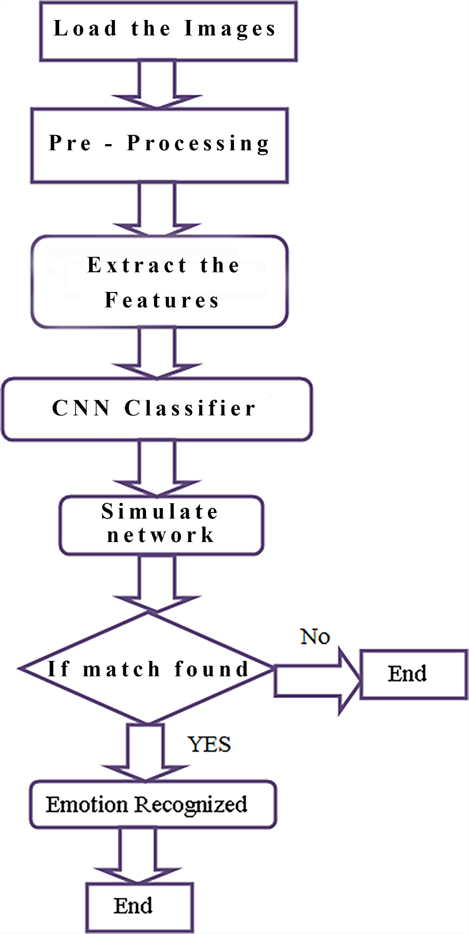
OVER-ALL ARCHICTECTURE DIAGRAM

Slide 7
FACE DETECTION
Face detection involves using computer algorithms to locate and identify human faces in digital images or video.
The process typically involves analyzing the image to locate regions that resemble a face, and then using additional algorithms to confirm that these regions are in fact faces.
There are several techniques that can be used for face detection like convolutional neural networks (CNNs).

Slide 8
FEATURE LEARNING
Feature learning, also known as representation learning, is a technique used in machine learning to automatically discover and extract useful features from raw data.
These features can then be used as inputs to a model, such as a classifier, to improve its performance.
The goal of feature learning is to identify patterns in the data that are useful for the task at hand, such as identifying objects in an image or recognizing speech. This can be done by training a model, such as a neural network, to learn a set of features from the data.

Slide 9
CNN CLASSIFIER
A CNN classifier works by processing an image through multiple layers, each layer extracting features from the image.
The final layer of the CNN classifier is a fully connected layer, also known as a dense layer, which outputs the class probabilities for the input image.
The network is trained using a dataset of labeled images, where the network learns to associate different features with different classes. During the testing phase, an image is passed through the trained CNN, and the class with the highest probability is output as the prediction.

Slide 10
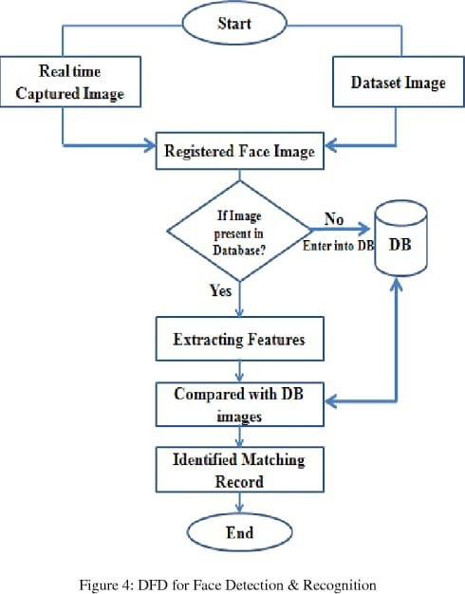
FACE DETECTION

Slide 11
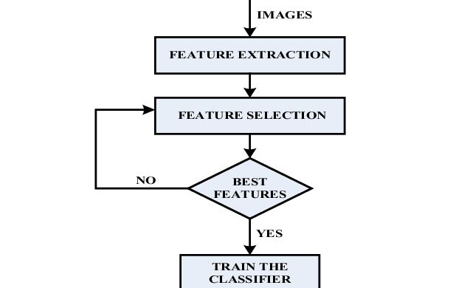
FEATURE LEARNING

Slide 12
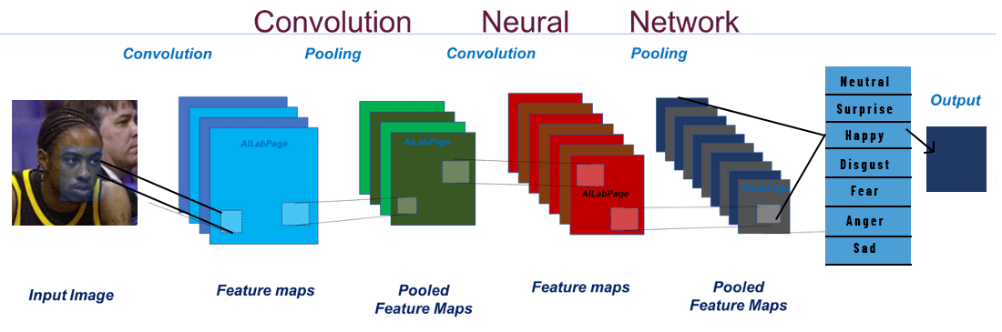
CNN CLASSIFIER

Slide 13
SAMPLE CODE
import numpy as np
import pandas as pd
import matplotlib.pyplot as plt
from keras.layers import Flatten, Dense
from keras.models import Model
from keras_preprocessing.image import ImageDataGenerator , img_to_array, load_img
from keras.applications.mobilenet import MobileNet, preprocess_input
from keras.losses import categorical_crossentropy
# Working with pre trained model
base_model = MobileNet( input_shape=(224,224,3), include_top= False )
for layer in base_model.layers:
layer.trainable = False

Slide 14
SAMPLE CODE
x = Flatten()(base_model.output)
x = Dense(units=7 , activation='softmax' )(x)
# creating our model.
model = Model(base_model.input, x)
model.compile(optimizer='adam', loss= categorical_crossentropy , metrics=['accuracy'] )
train_datagen = ImageDataGenerator(
zoom_range = 0.2,
shear_range = 0.2,
horizontal_flip=True,
rescale = 1./255
)
train_data = train_datagen.flow_from_directory(directory= "/content/train",
target_size=(224,224),
batch_size=32,
)

Slide 15
SAMPLE CODE
val_datagen = ImageDataGenerator(rescale = 1./255 )
val_data = val_datagen.flow_from_directory(directory= "/content/train",
target_size=(224,224),
batch_size=32,
)
# to visualize the images in the traing data denerator
t_img , label = train_data.next()
# function when called will prot the images
def plotImages(img_arr, label):
input :- images array
output :- plots the images
count = 0

Slide 16
SAMPLE CODE
# just to map o/p values
op = dict(zip( train_data.class_indices.values(), train_data.class_indices.keys()))
# path for the image to see if it predics correct class
path = "/content/face1.jpg"
img = load_img(path, target_size=(224,224) )
i = img_to_array(img)/255
input_arr = np.array([i])
input_arr.shape
pred = np.argmax(model.predict(input_arr))
print(f" The person in the image was {op[pred]}")
# to display the image
plt.imshow(input_arr[0])
plt.title("input image")
plt.show()

Slide 17
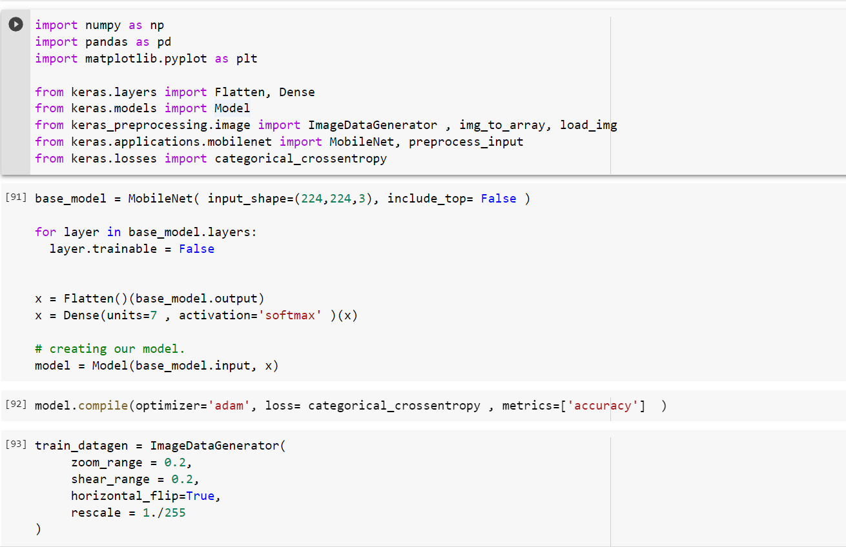
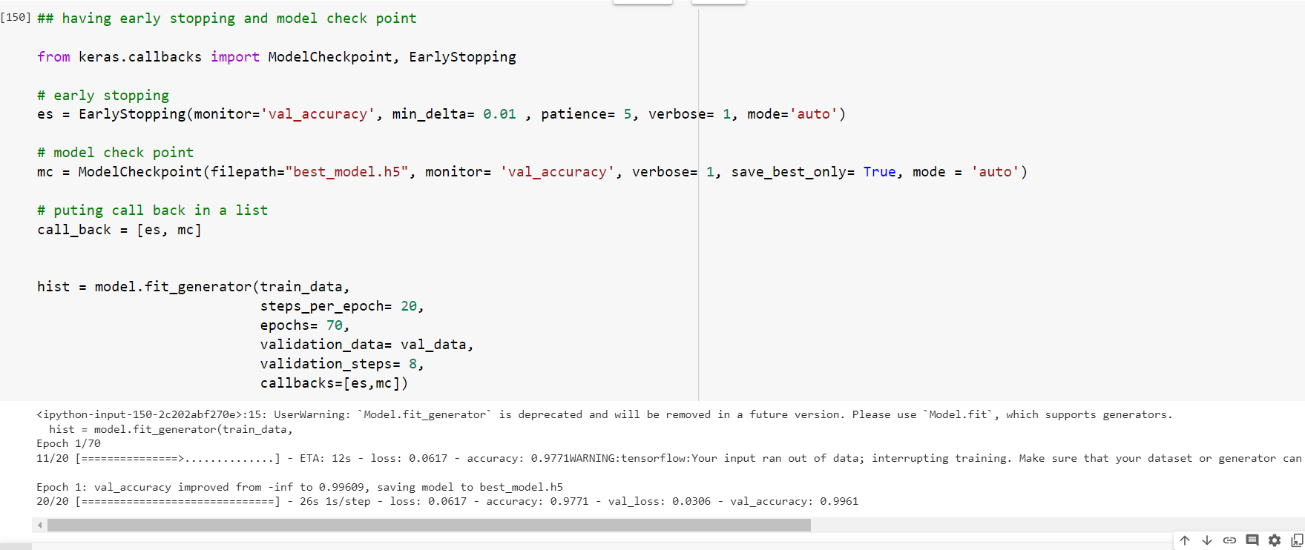
SAMPLE SCREENSHOT

Slide 18
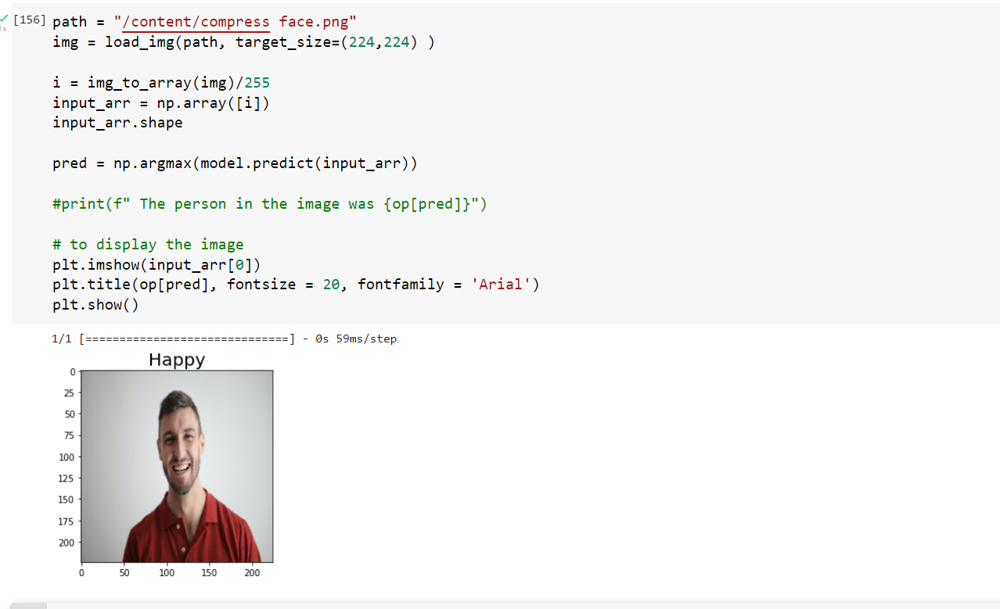
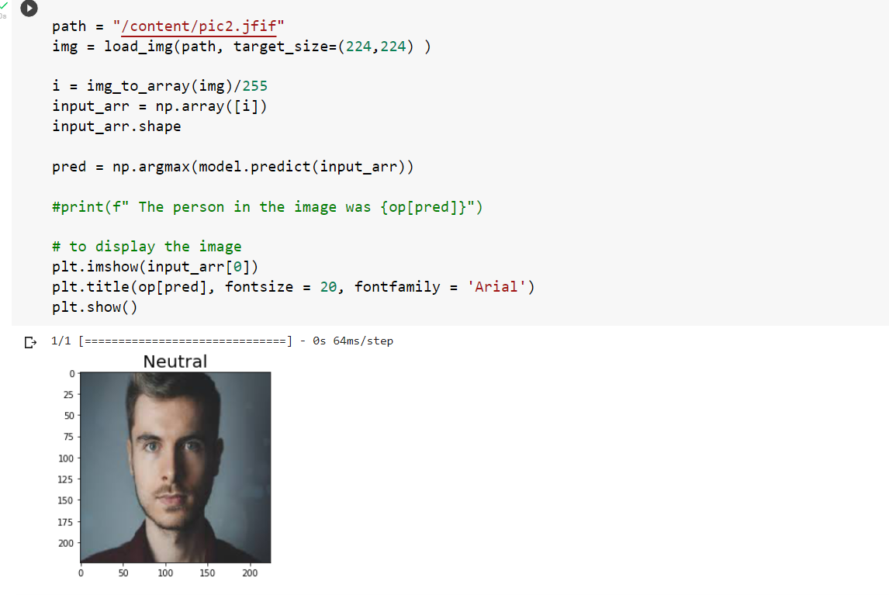
SAMPLE SCREENSHOT

Slide 19
REFERENCE
X. Zhao, S. Zhang and B. Lei, “Facial expression recognition based on local binary patterns and local fisher discriminant analysis,” WSEAS Transactions on Signal Processing, vol. 8, no. 1. pp.21-31, 2012.
C. Darwin, The expression of the emotions in man and animals. D. Appleton And Company, New York, USA, 1899.
Tian. Y. I., T. Kanade, and J. F. Cohn, "Recognizing action units for facial expression analysis,"IEEE Transactions on Pattern Analysis and Machine Intelligence, 2001, pp. 97-115.
https://ieeexplore.ieee.org/document/9972510
https://ieeexplore.ieee.org/document/9302866

